Slide 1
Reckitt Business Case
-
Sustainability Metric Prediction
Created by Amadeusz Kosędek

Slide 2
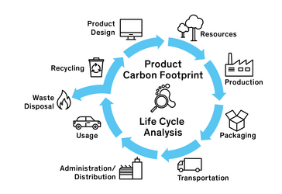
Intro
Nowadays companies put much more emphasis of environmental impact of their activities. The most widely used metric for this case is carbon footprint which is intuitive, universal and comparable among the market participants. A subset of total company’s carbon footprint is PCF (product carbon footprint) which on individual level is assessed based on product’s life cycle divided in stages:

Slide 3

According to relatively new EU’s directives large companies will be (some already are) obligated to report their environmental impact to establish market transparency and push businesses to reduce their weight in climate change. By The Green Deal policy EU is expected to achieve climate neutrality by 2050 which has to be backed by measurement, assessment and impact reduction. Financial institution already rate their customers based on “eco friendliness”.

Slide 4

We gathered long history of environmental impact data from various factories and our goal is to propose a model that will estimate aggregated products carbon footprint as accurately as possible enabling us to set reduction targets.

Slide 5
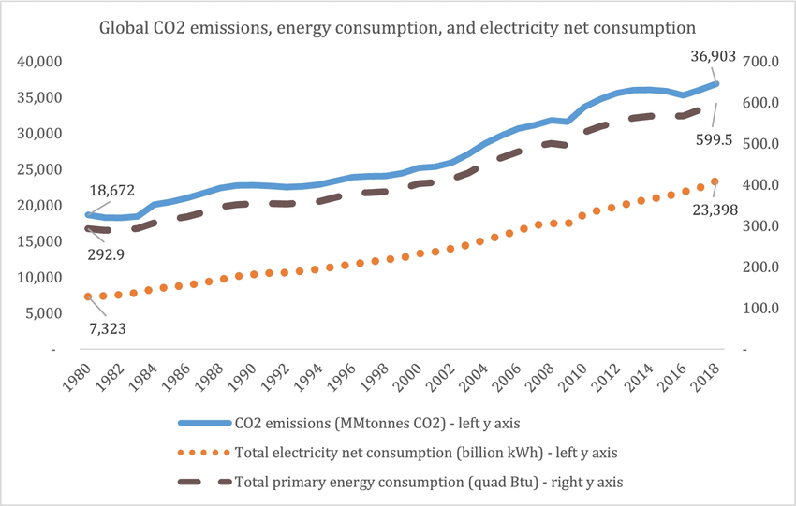
Empirically it is expected that emissions mimic linear function of energy consumption especially on aggregates, unless the energy comes mostly from renewable sources. Example of such relationship is clearly visible on the figure below.
Figure from C. P. Nguyen The “karma” of impact on the Earth: will humans take responsibility? Evidence of energy consumption and CO2 emissions

Slide 6
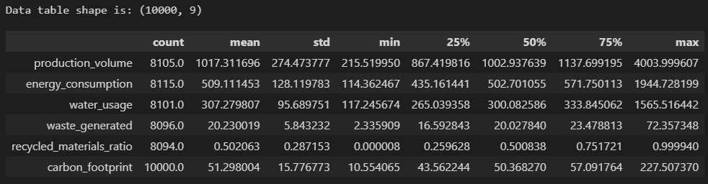
What data did we collect?
The dataset is a time series indexed by reporting date with observations spaced in single day intervals for 27 years period. Features contains information about aggregated total emissions (carbon footprint) caused by products manufacturing grouped by factory location and product category. The aggregates are described by quantitative measures such as production volume, energy consumption, water usage, waste generated and recycled materials ratio.
Summary of numeric variables already tells us that the data is not complete, so here we begin analysis…

Slide 7
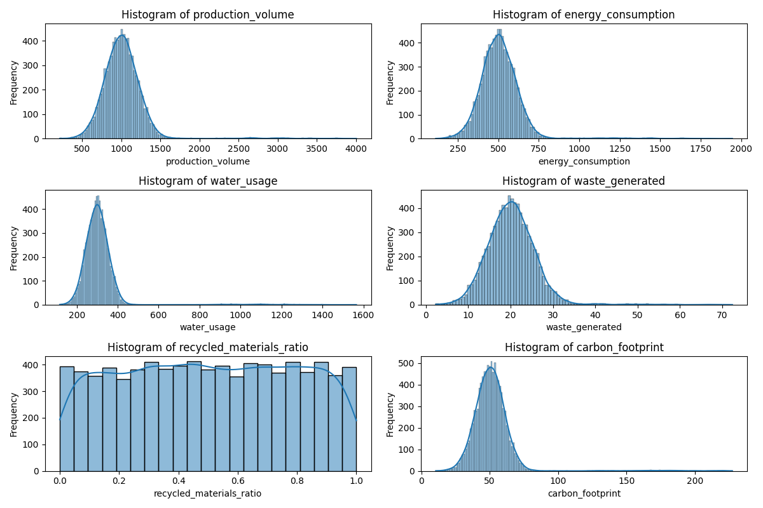
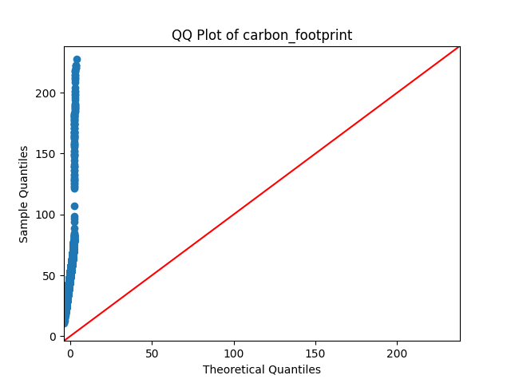
The empirical distributions of variables looks like bell shaped curves besides recycled material ratio which has understandably uniform distribution from 0-1 range. QQ plot makes it clear that there are few values in the upper quantiles of our data that might be outliers caused e. g by measurement errors. While maximum recorder carbon footprint value is 227 the sample probability of it being =< 100 is 0.99!

Slide 8
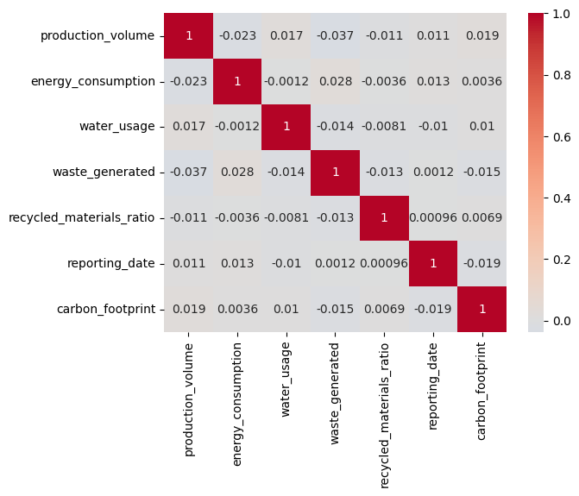
In order to dig deeper into the relationships between variables we plot correlation matrix. Suprisingly no pair of features has correlation coefficient with absolute value higher than 0.1. Linear relationship is almost non-existent in the dataset which is contrary to our hypothesis about carbon footprint to energy consumption relationship.

Slide 9
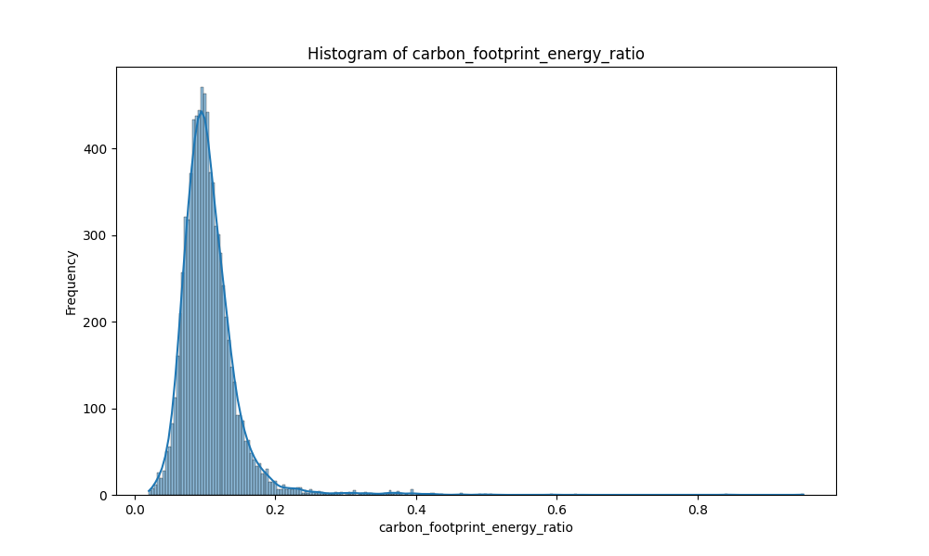
Another way to look at the carbon footprint and energy relation in the dataset is to plot histogram of their ratio. The mean value of 0.106 tells us that on average for each unit of energy consumed, there is an associated carbon footprint that is 10.6% of the energy value. This means that the units of this features might be kg CO2e / kWh or t CO2e / GWh. As for the ratio used in GHG Accounting – it’s average value for Europe is 0.320 which indeed may indicate that the energy measured in the data generating process possibly comes from clean energy sources.

Slide 10
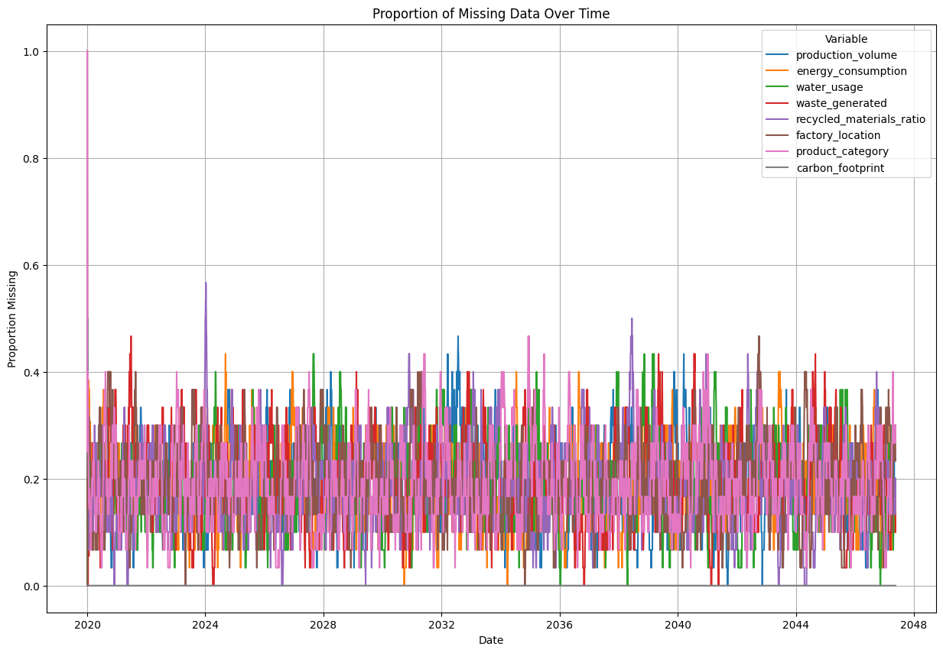
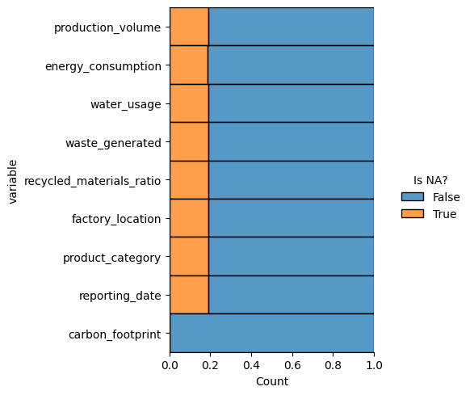
Important step in our analysis is data quality and completeness check
  Each feature (excluding carbon footprint which is our target variable) has 1885 – 1906 missing values which is ~ 20% of its total count. Only 1834 observations have no missing values. The pattern of missing data seems to be random with high variability at first sight.

Slide 11
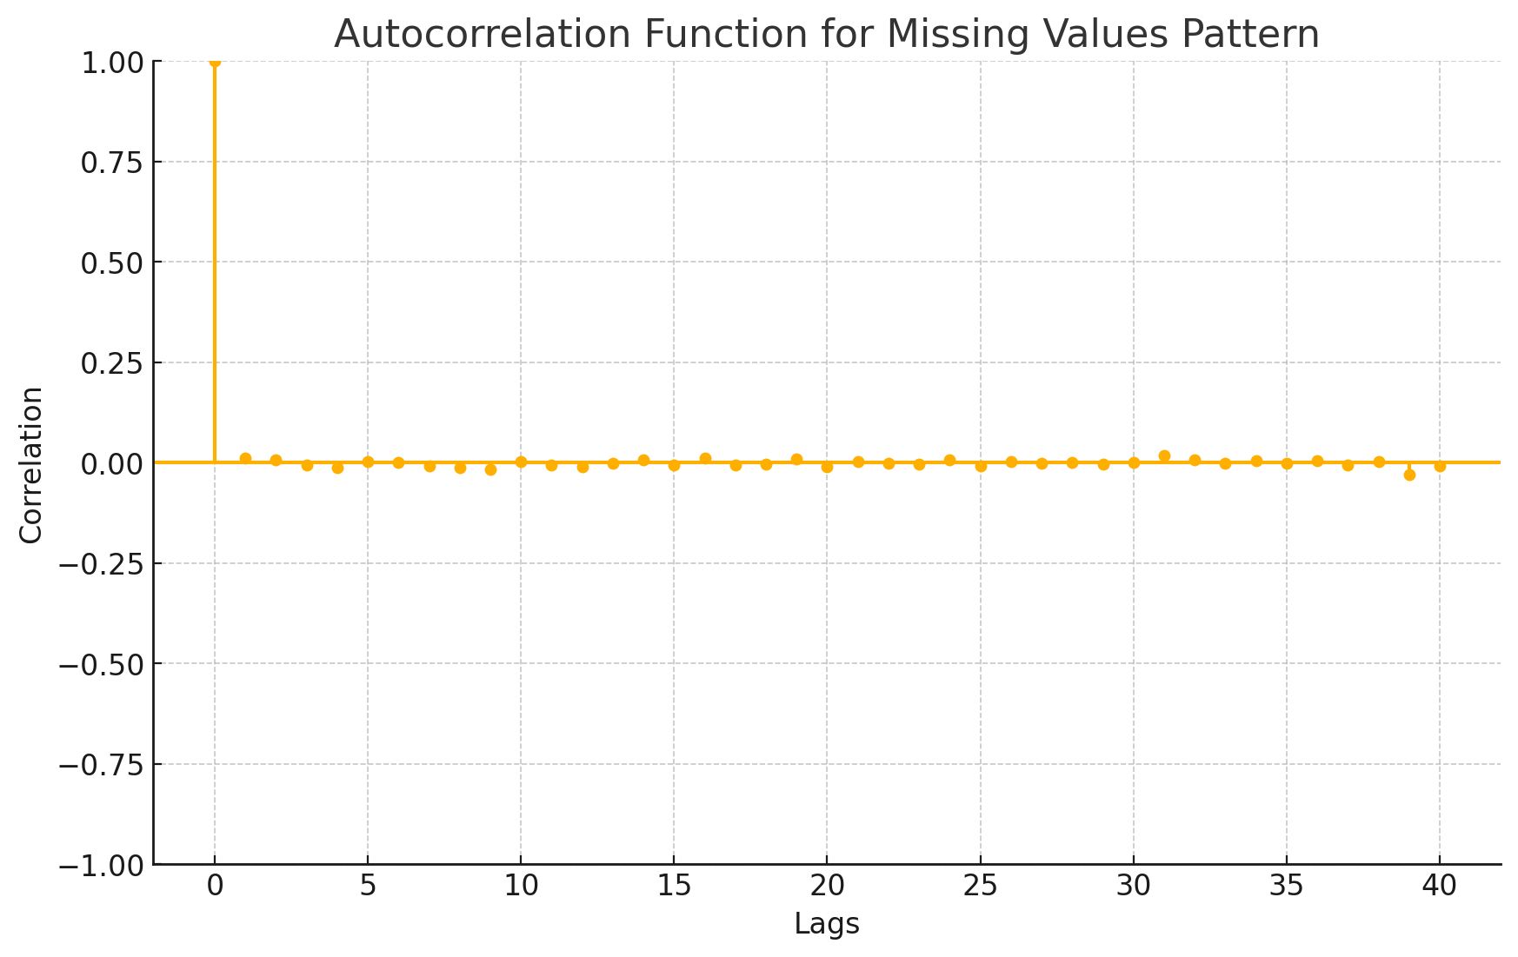
The pattern seems to have stable but high variance which leads us to high noise suspicion. We proceed by plotting autocorrelation function of the series
ACF values are very close to zero indicating white noise process. They are not exactly equal to zero as there is some random variation.

Slide 12
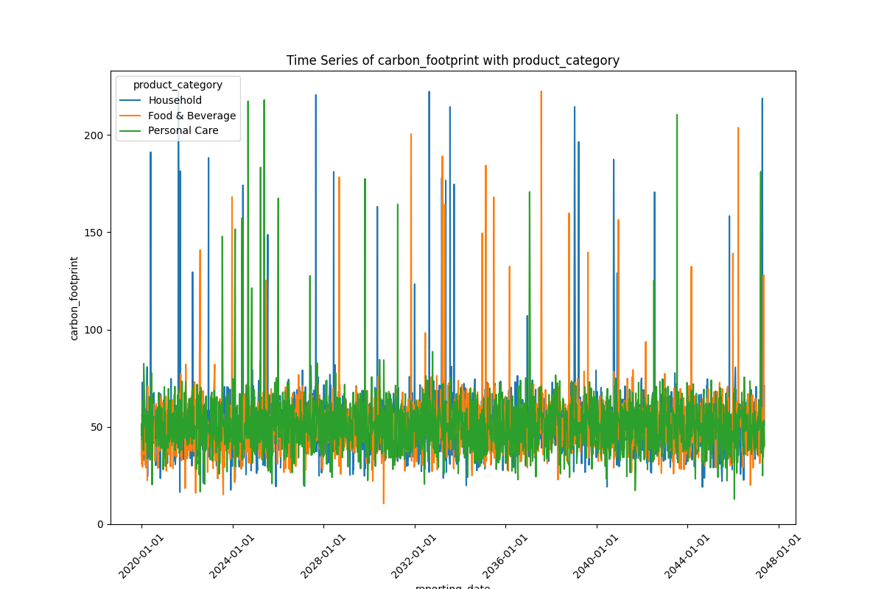
This situation is quite unusual so we decide to take a look at the variables themselves before we proceed.
The series seems to have similar characteristic as our missing data series. Other features indicate familiar patterns in their respective plots. The ACF is close to zero as well.

Slide 13
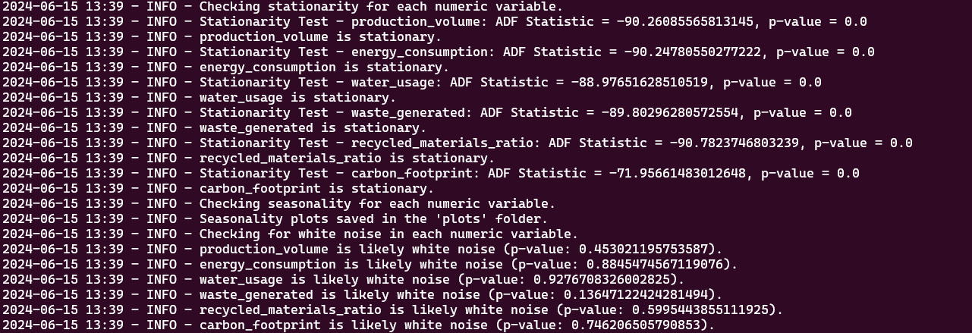
Toggle the table of contents
Ljung-Box statistical tests indeed indicate that the series might be a white noise – the closer to 1 is the probability of Type I error the more confident we are in this conclusion. The series are stationary as well according to Augmented Dickey-Fuller test. The testing process is visible in logs from the Python script:

Slide 14
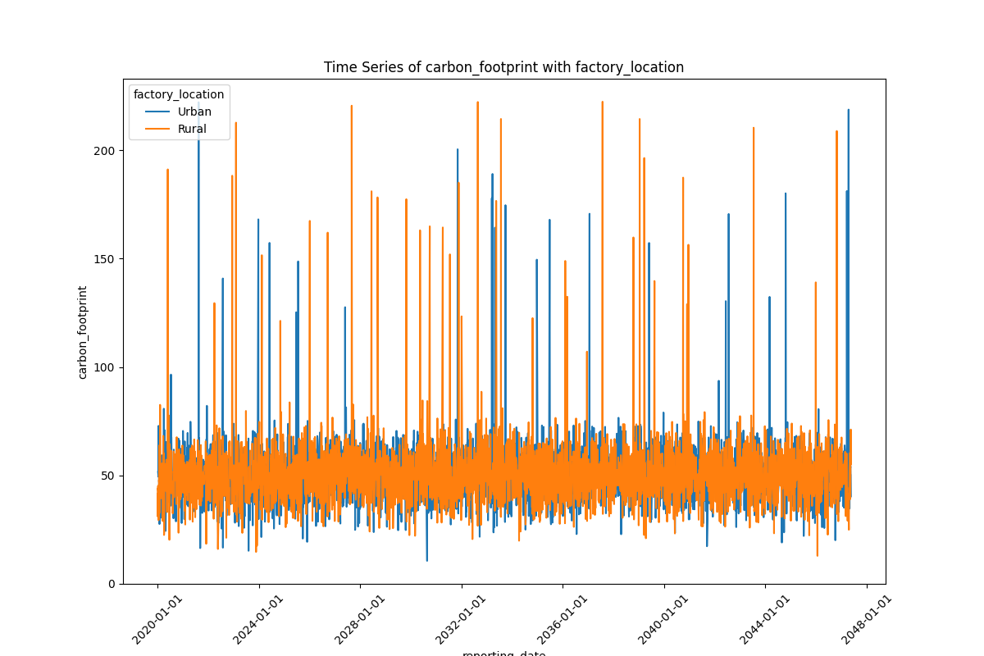
We decided to drop both categorical columns (factory location, product category) as all the series do not indicate difference in distribution among values of these two features (we show plot only for single series which is our target variable)

Slide 15
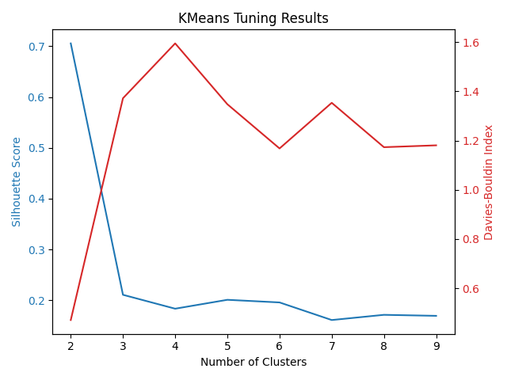
It’s risky to impute the missing values at this point as we have more tools in our toolbox to explore the dataset
Before we make any further conclusions, let’s use unsupervised learning and try to create clusters on a subset of data that have no missing values using K-Means.
The algorithm is programmed so that the number of cluster is chosen based on multi-objective optimization between Silhouette Score and Davies-Bouldin Index. As we see the best number is 2:

Slide 16
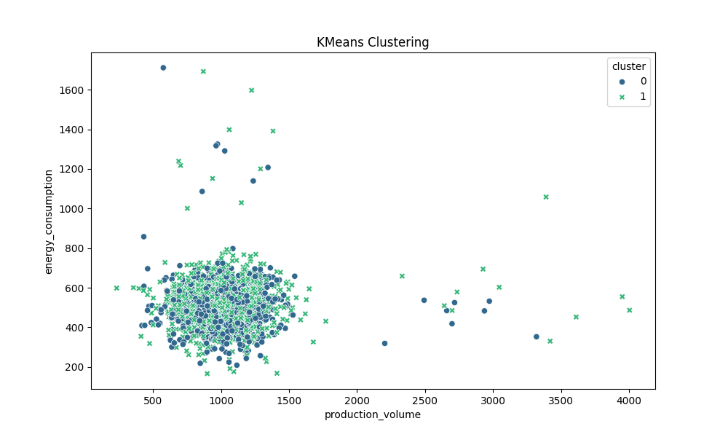
A Davies-Bouldin Index of almost 1.92 suggests that the average "similarity" within the cluster is not significantly lower than the similarity between clusters. This could imply that the clusters might not be well-defined. David-Bouldin score of 0.198 suggests that clusters are not very dense or well-separated. This means that the clustering configuration is somewhat weak and cluster membership overlaps considerably. We ran the algorithm multiple times to mitigate the risk of wrong starting points and we also tried to cluster the dataset with filtered out observations that has carbon/energy ratio > 0.3. Clustering efficiency metrics remains very similar in each case. The example visualization of the cluster:

Slide 17
Conclusion
Considering that the dataset probably comes from white noise process with almost non-existent autocorrelation, statistically significant stationarity and our unsuccessful attempts to find the signal – by the Law of Large Numbers the best estimator of carbon footprint in this case is the expected value of the sample which is its arithmetic mean.

Slide 18
Thank you for your time : )

